Slide 1






Developed by:-
Deepit Aggarwal
Course:- BCA
Semester:- Third
Roll No.:- 07
College:-JIMS,Rohini,Sec-3
Project Topic:- Travel India Management System

Slide 2
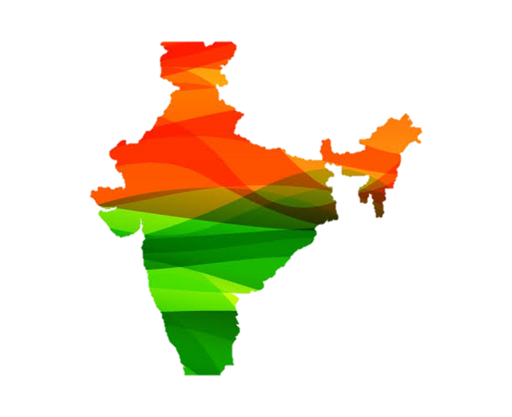
Introduction
India one of the most beautiful location of South Asia is also among the popular countries of the world.
Tourist hub welcomes more than a 10 million tourists from different locations of the world.
A trip to this beautiful country can reveal numerous mystic things regarding its culture , art , tradition , history etc.

Slide 3
Objective
Offer a variety of travel services that are sure to match all your priorities.
Make the application used by the user during there routine life as well as for travelling for booking bus tickets, train tickets as well as hotels for their personal as well as professional life.
Make strong relationship with customers so that they can enjoy the holiday of their dreams.
To promote responsible and interesting tourism so that people can enjoy their holidays at their favorable places.

Slide 4
Operating Environment – Hardware and Software
Hardware Requirements :
Processor-: Pentium 4 or more for optimum performance
RAM-: Recommended 256MB
Hard Disk-: Minimum 20GB
Software Requirements :
Operating System -: Certified Distribution of WINDOWS
Visual -:Basic 2005 Express Edition
Database(Backend) -: MS Access 2003

Slide 5

Problem Initiative of the current system
Time consuming
Less accurate
Less efficient
Lot of paperwork
Slow data processing
Not user-friendly environment
Difficult to keep old records

Slide 6
Our Solution Description
login Page
A single login page for making all the booking
Bus Booking
Can Book all the bus tickets using a single system.
Hotel Booking
Can book any hotel according to customer as per there choice as well as affordability
Train Booking
Train tickets can be booked and cancelled easily

Slide 7

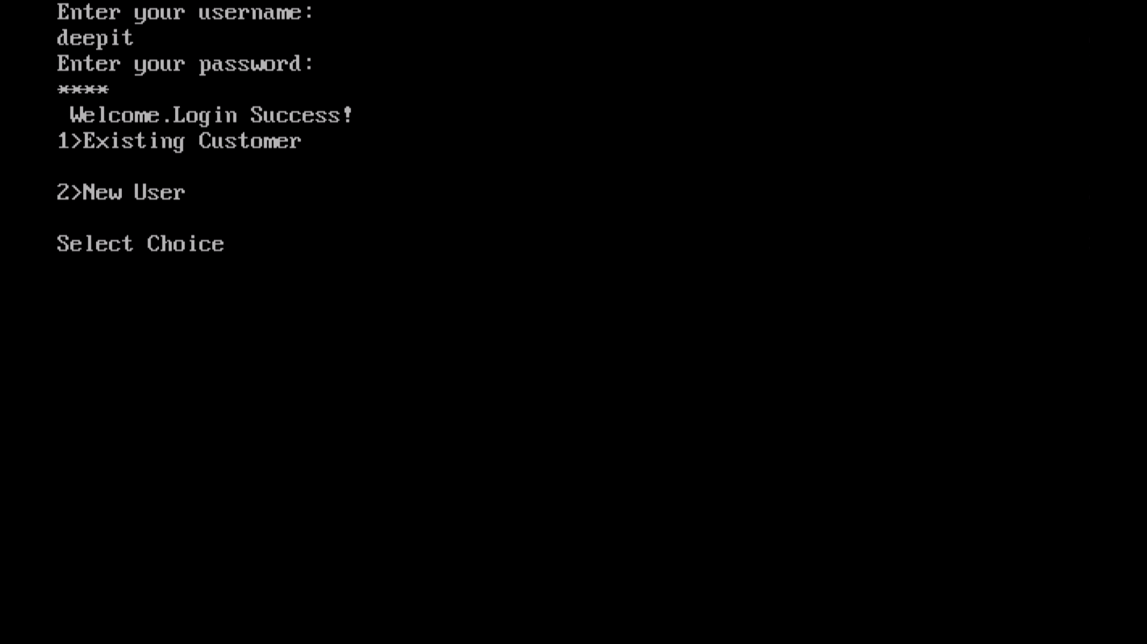
Main Login
The options to the customer are given bellow:
Add The Customer User
In this function, we are adding the details like Customer ID, Name , Phone Number, E-mail, Preferred Travel Means and City.
Modify The Details Of Student
In this function, we are modifying the record of the user by Customer Id of customer

Slide 8

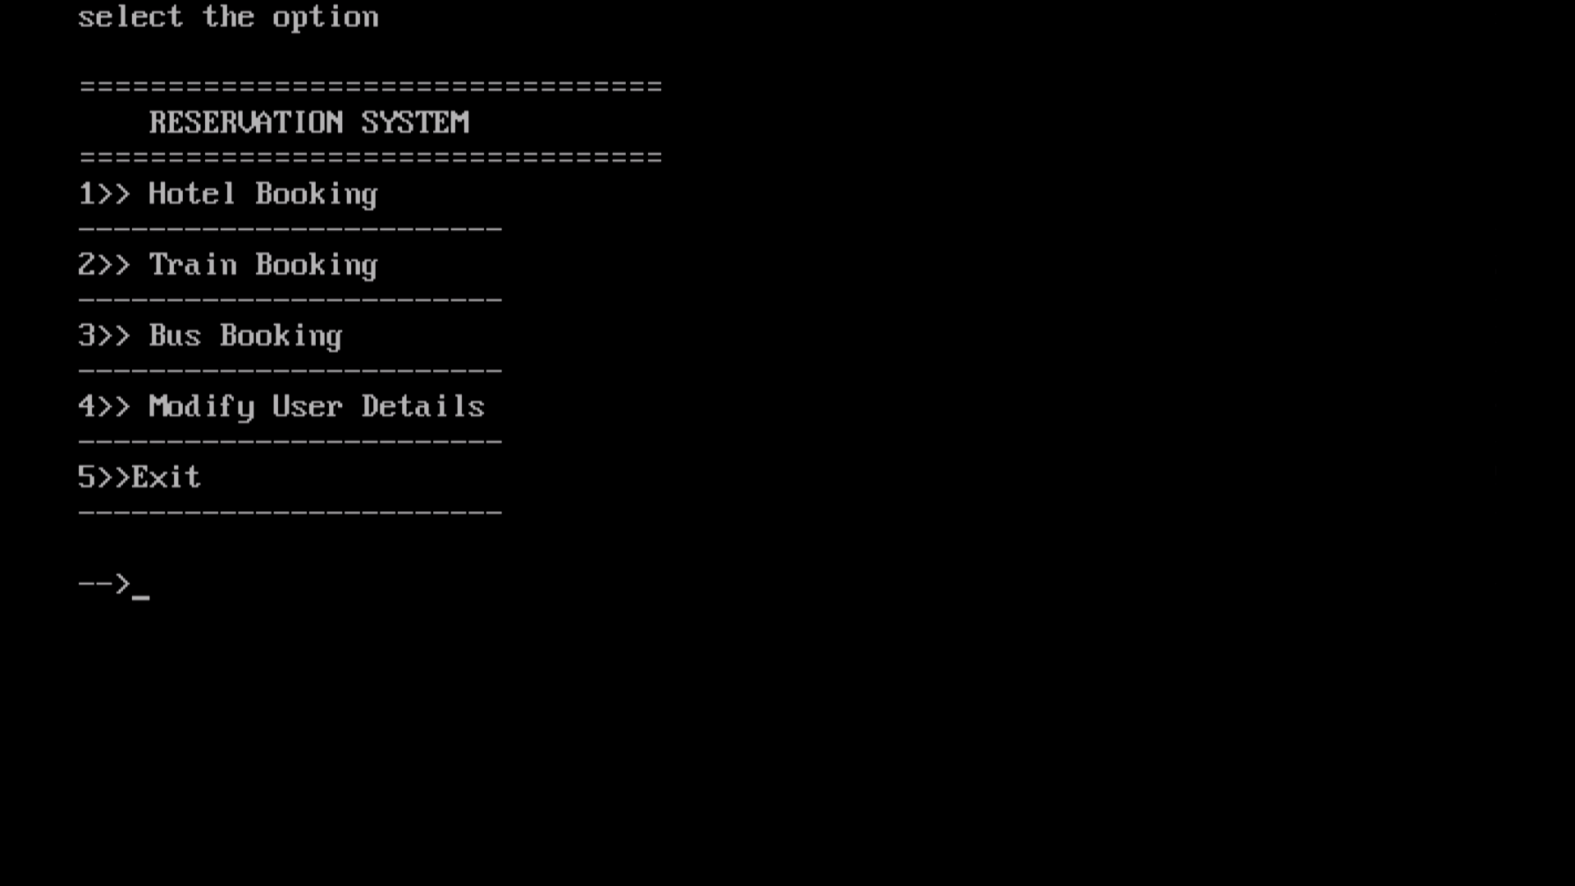
Hotel Booking
The options to the customer are given bellow: -
Book Hotel
In this function, we are booking the hotel with help of the customer id already generated at the time of user registration.
Display Booking
In this function, we are displaying booking of the hotel with help of the customer id already generated at the time of user registration.
Cancelling Booking
In this function, we are cancelling booking of the hotel with help of the customer id already generated at the time of user registration.

Slide 9

Train Booking
The options to the customer are given bellow: -
Book Train Ticket
In this function, we are booking the train ticket with help of the customer id and name of the ticket holder.
View Available Trains
In this function, we are showing the trains available along with the cost of ticket and time.
Cancelling Booking
In this function, we are cancelling booking of the hotel with help of the customer id already generated at the time of user registration.

Slide 10

Bus Booking
The options to the customer are given bellow: -
View Bus List
In this function, we are displaying the list of the busses available.
Book Bus Ticket
In this function, we are booking the bus ticket with help of the customer id and name of the ticket holder.
Cancelling Booking
In this function, we are cancelling booking of the hotel with help of the customer id already generated at the time of user registration.
Boarding Status
In this function, we are showing the status of the bus according to the booked tickets with the help of bus number.

Slide 11
Capabilities Chart
Book Bus Tickets
Book Hotels
Book Train Tickets
Search Booking
Cancel Booking
Maintain Records

Slide 12

Validation for Phone Number
printf("Enter User Phone Number \n");
xyz:
fflush(stdin);
gets(u.Phone_No);
l = strlen(u.Phone_No);
for(i = 0; i < l; i++) {
if(u.Phone_No[i] < 8 && u.Phone_No[i] > 10) {
goto pq;
}
if(u.Phone_No[i] >= '0' && u.Phone_No[i] <= '9') {
flag = 0;
}
else {
pq:
printf("Enter Valid Phone NUmber Only!!!\n");
flag = 1;
break;
}
}
if(flag == 1) {
printf("Enter the Phone No. again!!");
goto xyz;
}

Slide 13
Validation for names
printf("Enter User name \n");
abc:
fflush(stdin);
gets(u.Name);
l = strlen(u.Name);
for(i = 0; i < l; i++) {
if(u.Name[i] >= 'a' && u.Name[i] <= 'z' || u.Name[i] >= 'A' && u.Name[i] <= 'Z') {
flag = 0;
}
else {
printf("Enter Valid Name Only!!!(Enter alphabets only(a-z or A-Z))");
flag = 1;
break;
}
}
if(flag == 1) {
printf("Enter the name again!!");
goto abc;
}

Slide 14

SCREENSHOTS

Slide 15
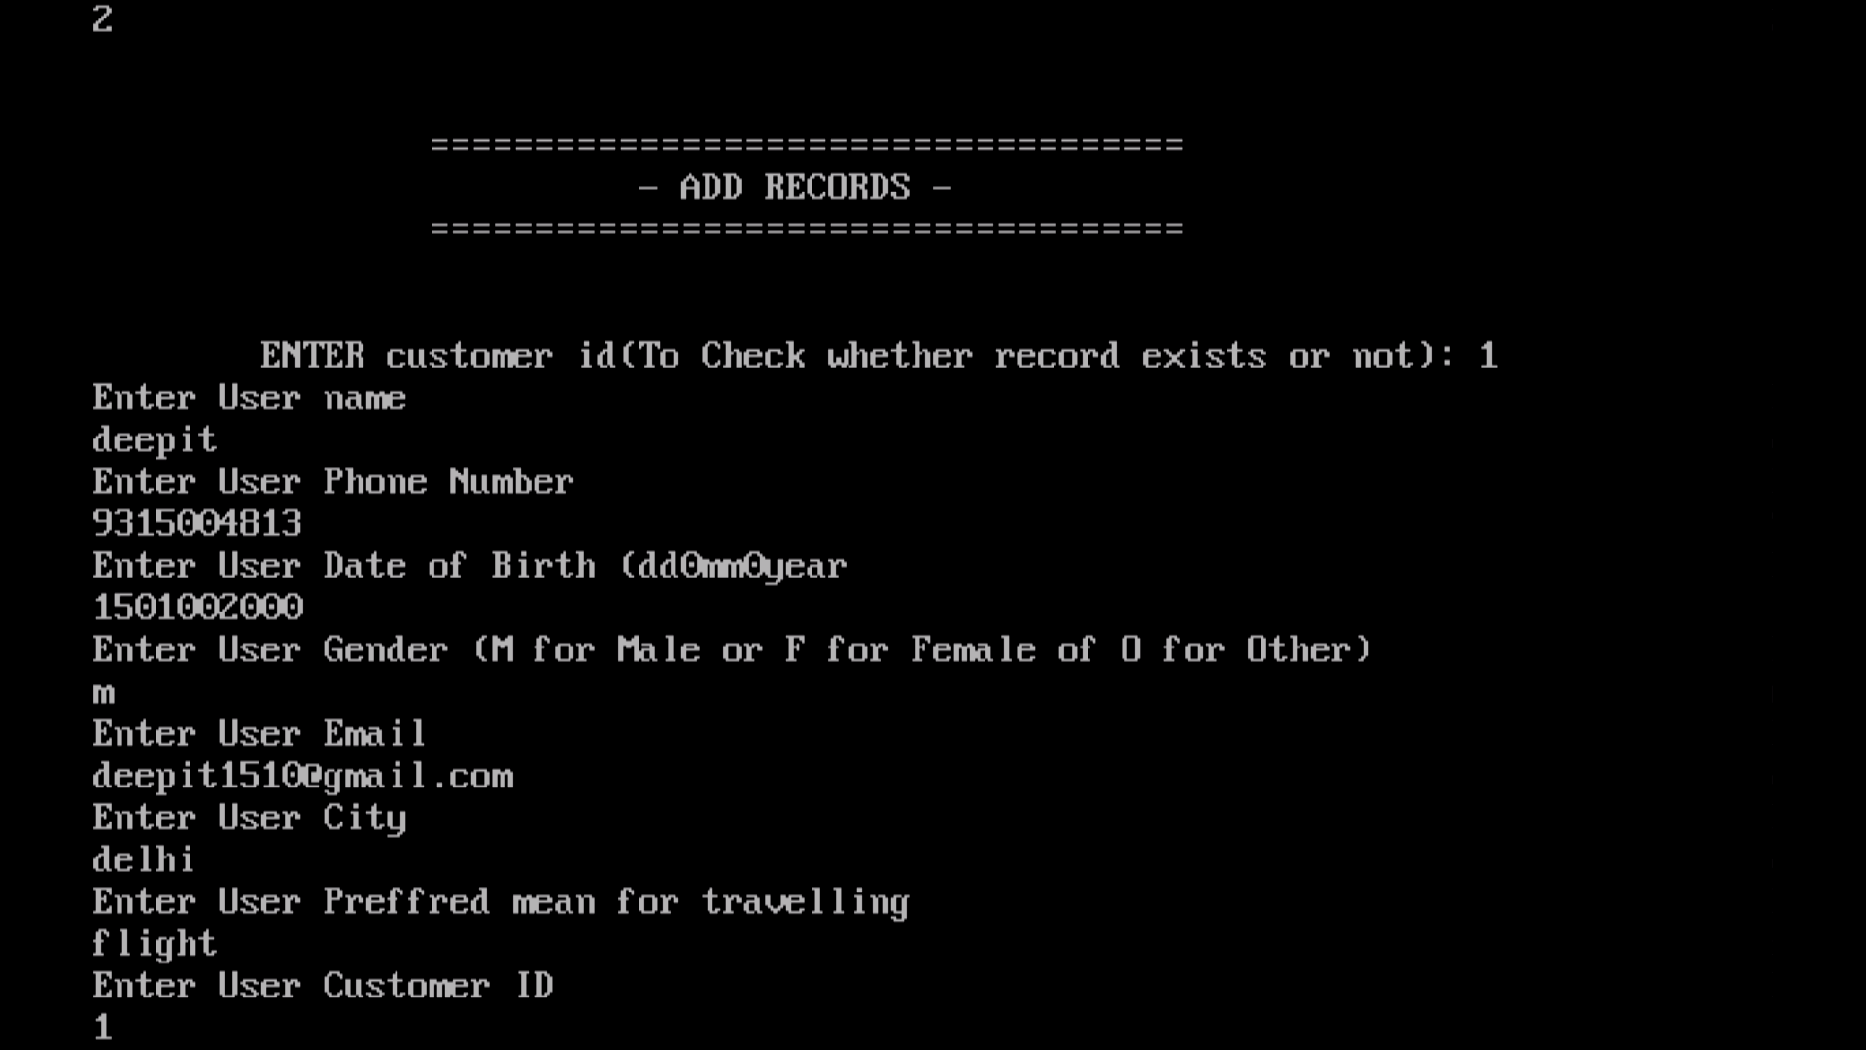
Login
New Customer Registration

Slide 16
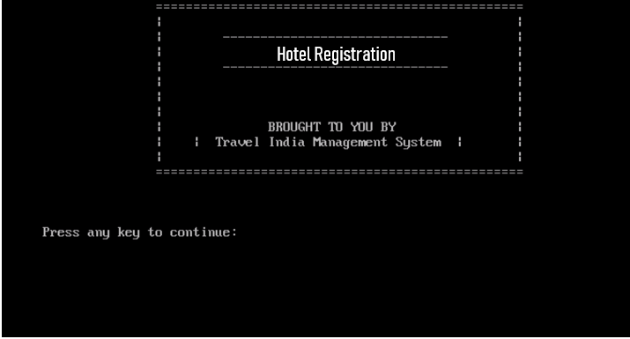
Main Page
Hotel Registration
Main Page

Slide 17
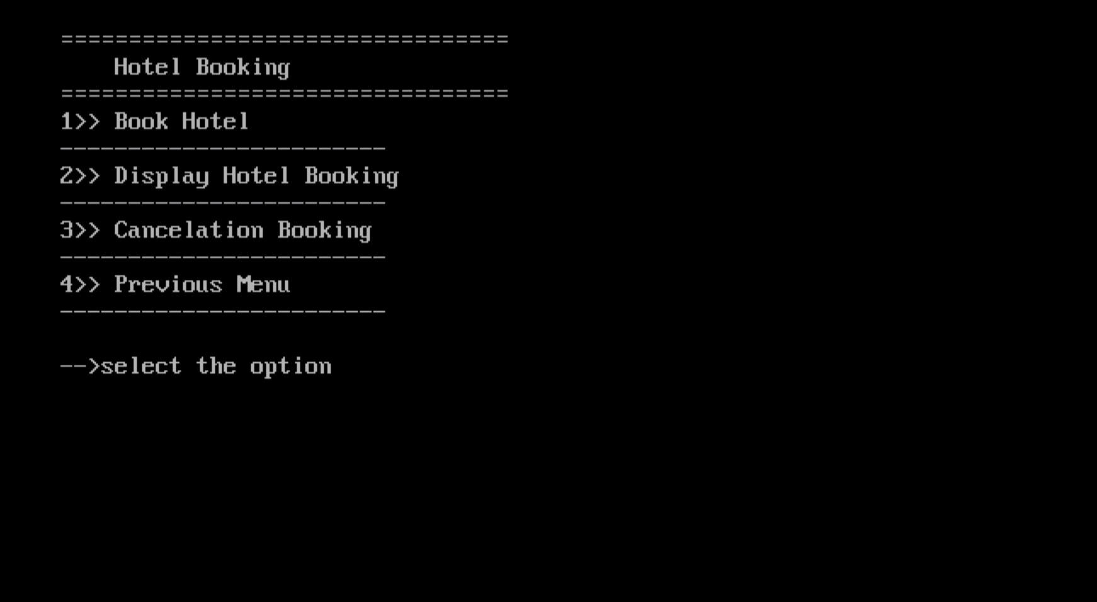
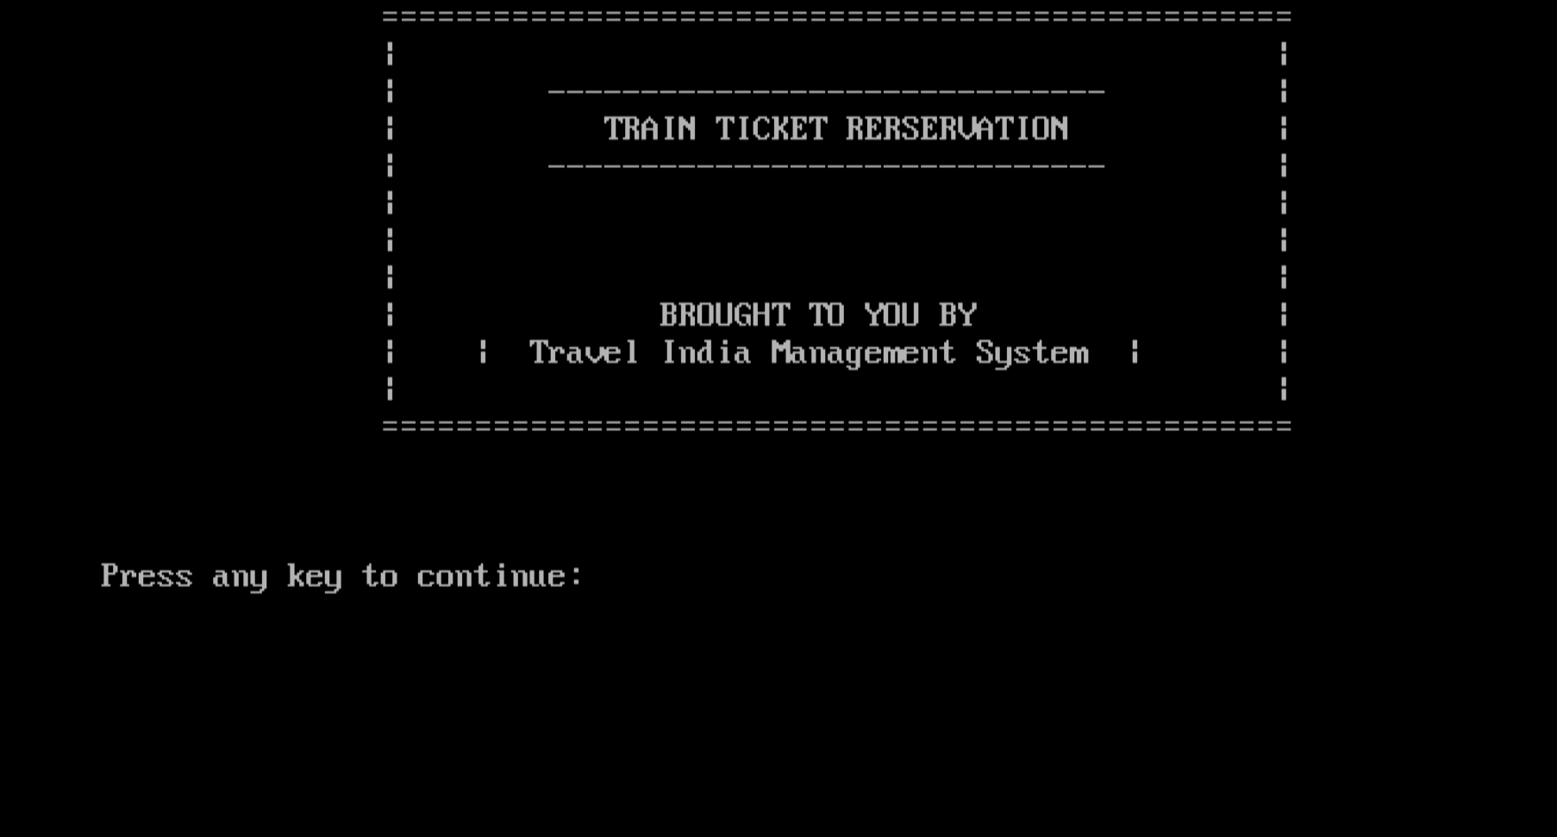
Hotel Registration
Page
Train Registration
Main Page

Slide 18
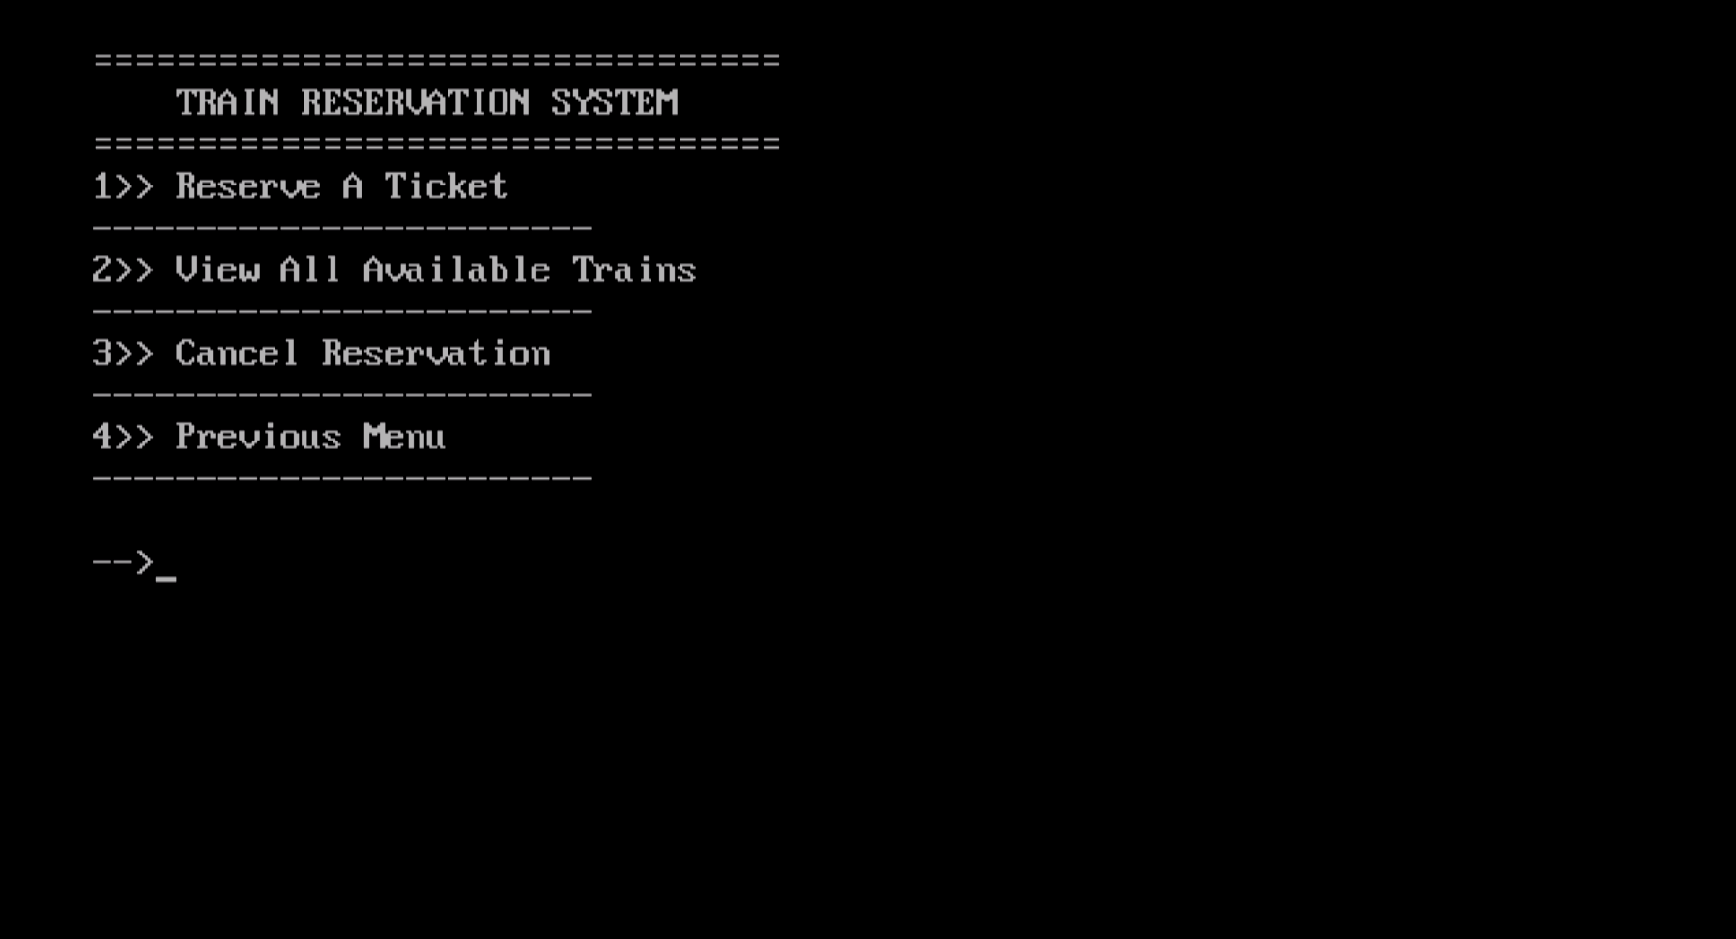
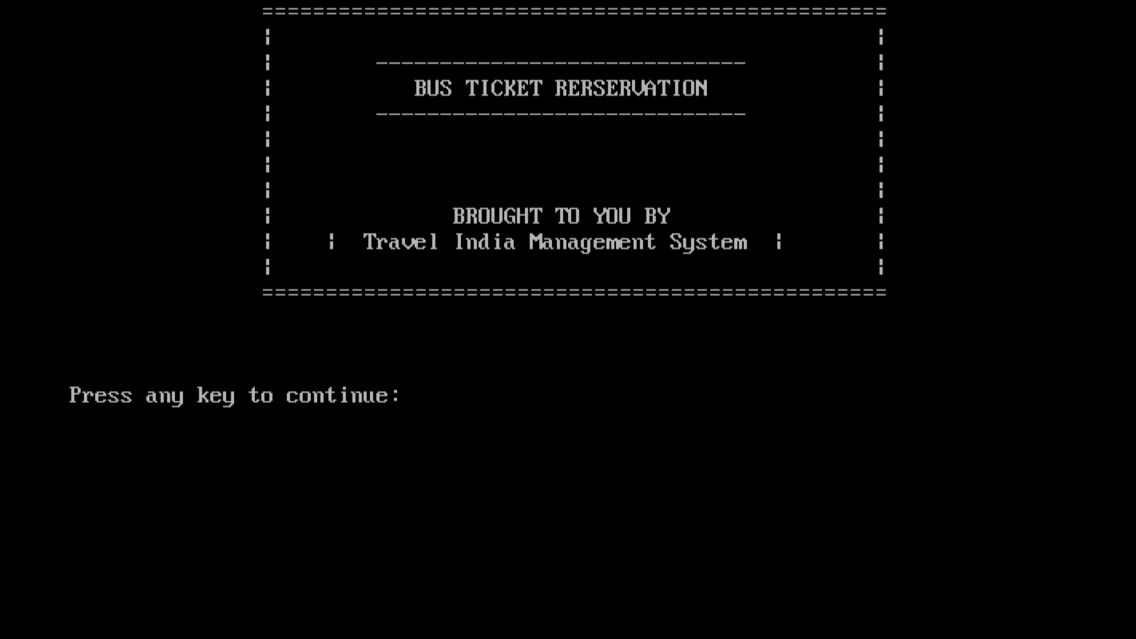
Train Registration
Page
Bus Registration
Main Page

Slide 19
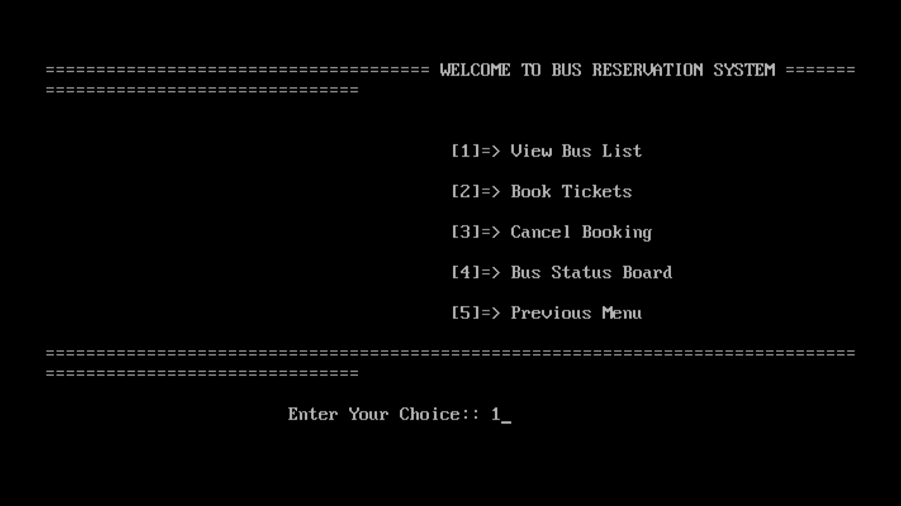
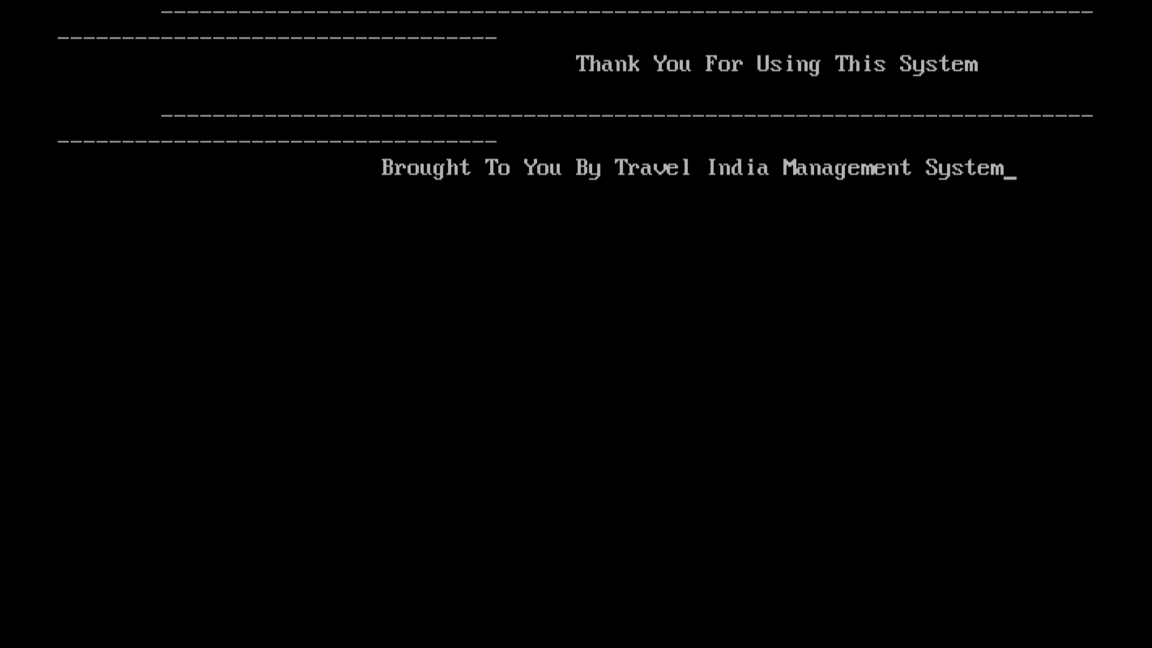
Bus Registration Page
End Page

Slide 20

Reference
Let Us C
By-Yashavant Kanetkar
Programming And Problem Solving Through ‘C’
By-Satish Jain
Geeksforgeeks.org
Javapoint.org
erdplus.com
Very thankful to
Mr. Mohit Mathur (Head of Department)
Mrs. Manisha Tripathi (Student Coordinator)
Mr. Nitin Saraswat (Guide)
Ms. Nainika (Guide)
Website

Slide 21

ANY Questions?

Slide 22

Thank You!

